Slide 1


VISHLESHAN ‘19
SUPERSTORE INT’L - Sales Plan
Team: T.V.S. To Jupiter
Rank: 25

Slide 2
Overview
SITUATION
Client - Superstore International, US Growing Year-Over-Year in office supplies
TASK
Identify least profitable areas Capitalise on the most valuable shipping mode Devise advertising strategy for 12 months in USD 5000 Forecast business for 3 years
Click here for Analysed Data

Slide 3
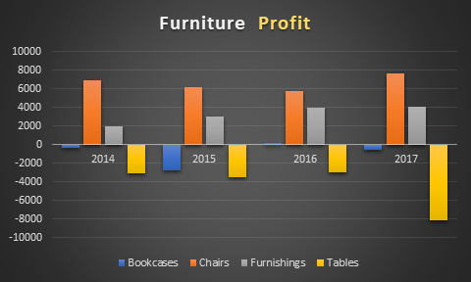
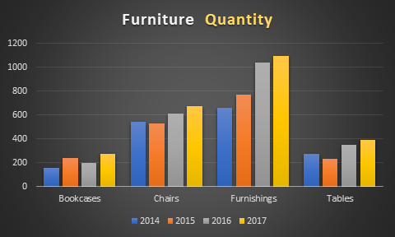
A) Bottleneck Categories 1
Least profitable - Furniture sector
Bottleneck sub-categories: Tables & Bookcases
Tables yielding 3 fold losses as compared to Bookcases
Tables include round tables, which are reqd in corporate segment
Corporate segment less profitable than Consumer segment
Bookcases, a requirement in Consumer sector, has increasing quantity.
Hence, divest from Tables.
Don’t divest from bookcases.

Slide 4
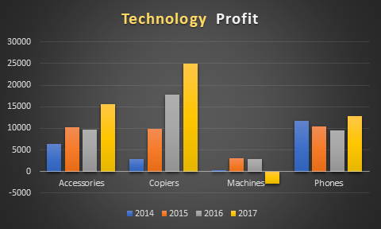
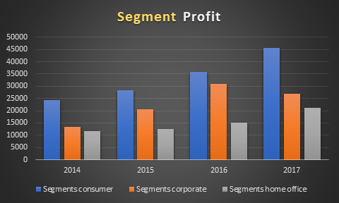
A) Bottleneck Categories 2
Bottleneck in Technology category: Machines
Machines mostly sold in Corporate sector
Quantity is stable as well
Low returns on machines
Divest from Machines

Slide 5
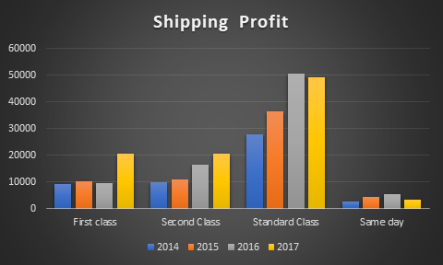
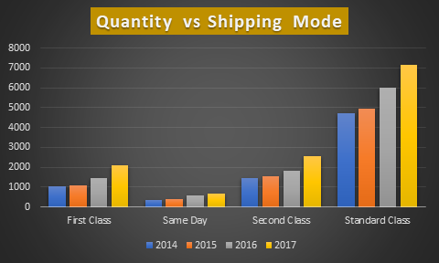
B) Shipping Mode
Most Valuable | Least Valuable
Standard Class | Same Day Delivery

Slide 6
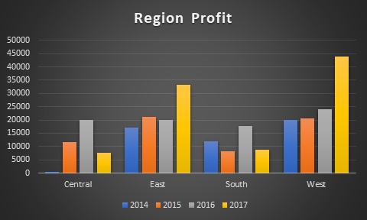
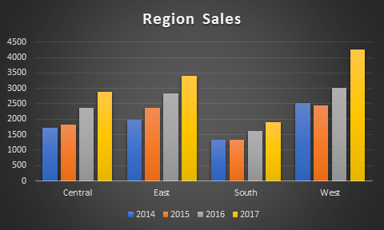
C) Advertising Strategy 1
Total budget: USD 5000
Duration: 12 months
West US generates the maximum profit
East region had comparable profit and sales to West till 2016
2017 has made East fall short in profits
So, Maximum budget to be invested in East US.
South region saw a major drop in profit 2017 though the sales were constant
So, South has potential to exploit advertisements
Assuming our client started operating in Central region from 2015, the growth depicts that it requires lesser advertisements compared to South
On the other hand, South shows similar profits but lesser sales
So, advertise more in South than Central

Slide 7
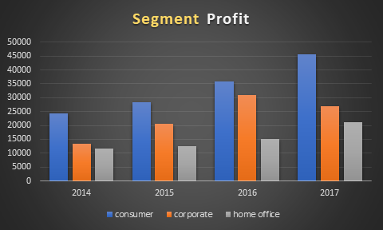
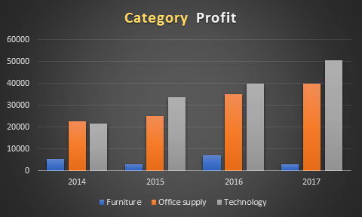
C) Advertising Strategy 2
East | West | South | Central
USD 2000 | USD 1500 | USD 1000 | USD 500
Segment-wise ad budget distribution (%)
Corporate | 60
Home Office | 30
Consumer | 10
Category-wise ad budget distribution (%)
Technology | 40
Office Supply | 40
Furniture | 20

Slide 8
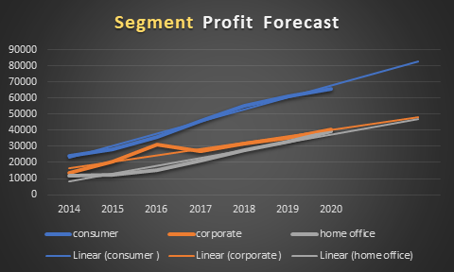
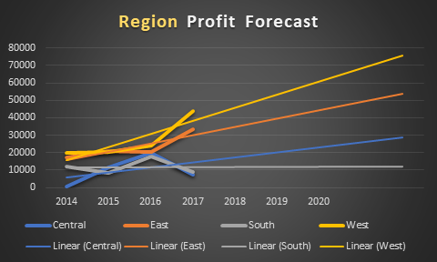
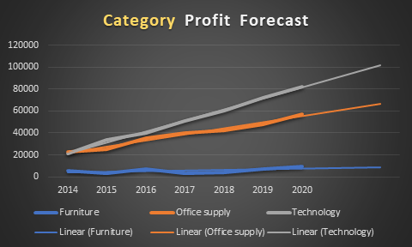
D) Business Forecast - 3 years (PROFIT)

Slide 9
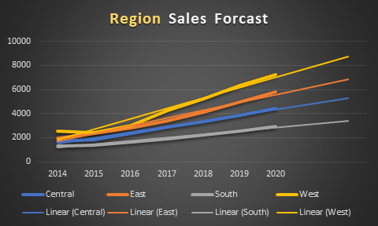
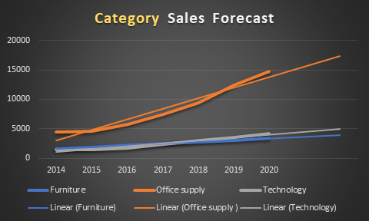
D) Business Forecast - 3 years (SALES)

Slide 10

THANK YOU!
T.V.S. to Jupiter
Tanay Kedia Vaibhav Singh Shivansh Gupta

